Slide 1

Ecommerce Sales Analysis – Microsoft Learn Club Final Project
from Microsoft Learn Student Club present our ecommerce sales analysis using Power BI.

Slide 2
Introduction & Credits
This project is created by
Ammar Gamal
Mahmoud Elkadeem.
Expertise
Collaboration
Strong foundation in data analytics and Power BI techniques.
Combining skills for comprehensive full-cycle project delivery.

Slide 3

Project Objective
Data Cleaning
Prepare clean and accurate ecommerce data for modeling.
Data Modeling
Develop a Galaxy Schema for efficient analysis.
Visualization
Create interactive dashboards for KPIs and trends.
Insights
Deliver actionable business recommendations.

Slide 4

Phase 1: Data Cleaning
Cleaned Data
Handled missing ProductID and removed unnecessary columns.
Data Type Validation
Verified and adjusted data types for accuracy.
Enriched Data
Created Full Name and filled null Regions with "Unknown".
Data Merging
Combined Orders with OrderDetails using OrderID key.

Slide 5
Phase 2: Data Modeling (Galaxy Schema)
Fact Tables
Dimension Tables
Relationships & Calculations
Orders
Customers
OrdersDetails
Employees
Many-to-one relationships
Shippers
Calculated Year, Month, Quarter, Weekday
Products
Suppliers
Categories

Slide 6
Phase 3: Dashboard Design
Overview (KPIs)
Top Products & Regions
Time-Based Analysis
Category Sales
Supplier Contribution
Shipping & Fulfillment
Insights & Recommendations
Each page features interactive slicers for dynamic filtering and analysis.

Slide 7
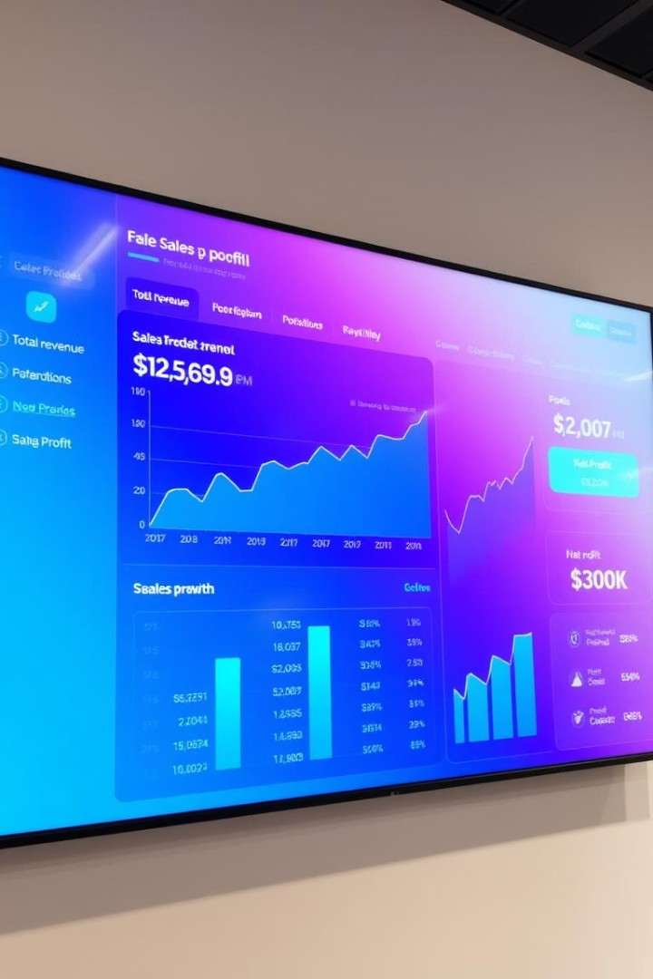
Key Metrics (KPIs)
51K
Total Quantity Sold
1.52K
Average Order Value
14.22K
AOV per Customer
830
Number of Orders

Slide 8

Top Performing Products
Product 1
141.3K
Product 2
80.37K
Product 3
71.16K
Top three products drive majority of sales; one shows possible data inconsistency.

Slide 9




Category Performance
Dairy
Meat/Poultry
Consistent sales share
Balanced quantity sold
Beverages
21.16% of total sales – strong leader
Groceries
Fairly distributed sales
2
3
1
4

Slide 10

Shipping Analysis
Average Shipping Time
Slowest Regions
South and West regions face delays
8.48 days across all shipments
Shipping Methods
Three methods used evenly, ensuring flexibility

Slide 11
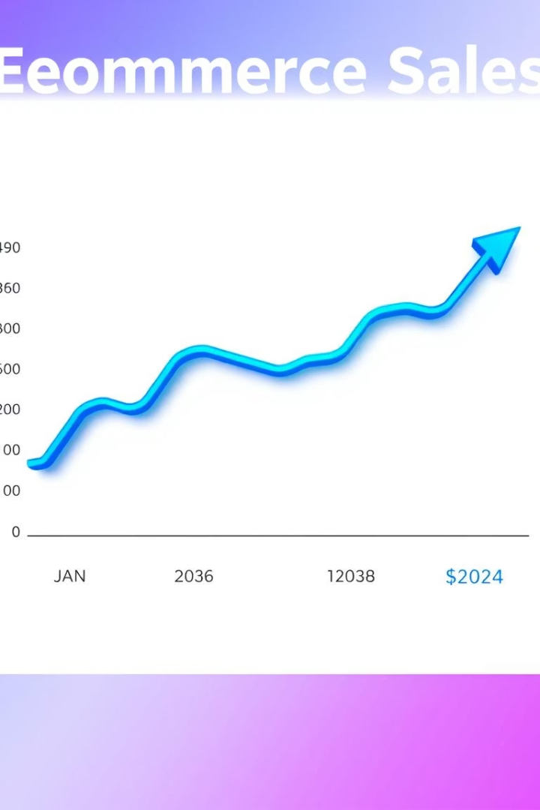


Time-Based Performance
Yearly Trends
Sales fluctuate between 1997 and 1998 with a notable peak
Monthly Patterns
High sales in January and February; lower in other months

Slide 12
Summary of Key Insights & Recommendations
Insights
Recommendations
Beverages lead sales with 21.16% share
Focus marketing on high-performing categories such as Beverages and Condiments
Over 35% of sales from USA-based suppliers
Shipping delays impact South and West regions
Optimize shipping to reduce delays and improve satisfaction
Top three products drive majority of revenue
Investigate and resolve data inconsistency in product sales
Use interactive dashboard slicers for dynamic analysis

Slide 13

Special Thanks & Acknowledgments
Microsoft Learn Student Club – Kafrelsheikh University
Gratitude for organizing impactful sessions and mentorship that boosted technical and professional growth.
Power BI Community Instructor
Appreciation for clear, practical instruction full of real-world business intelligence insights and passion.
This project’s success owes much to your guidance, support, and dedication throughout the learning journey.

